Slide 1
MRF Limited Stock Market Project Report
Instructor’s Name: Prof Qi Deng
Course Full Title: Business Analytics
Team Details:

Slide 2
INTRODUCTION
Overview of the MRF Limited Stock market
Seasonal Stock exchanges in the financial year
Future Trends/ forecast in the financial Market.

Slide 3
OBJECTIVES
To identify the over all trend of MRF Limited Stock exchange over the years, and determine the trading fluctuations on the market share value and explore the reasons behind the variation in the share price.
Analyze the seasonal patterns of share price comparison over the past share value and determine the causes for the fluctuations happening with stock exchange price such as record price of the share and low price of the share with certain times of the calendar year.
To predict the future forecast of stock exchange market price depending upon the gradual fluctuation of 1 share of MRF limited traded on one particular day. With this share values we can predict the share prices and trade the shares and sell it over a long period of time.
Based on the share price market value we can estimate the future trading values and go a head for trading the stock or sell the stock at higher prices and generate the savings according based on the market share prices
Basing on this we can estimate the sale patterns, by using various models, trends following while trading and follow the pattern or machine algorithm.

Slide 4
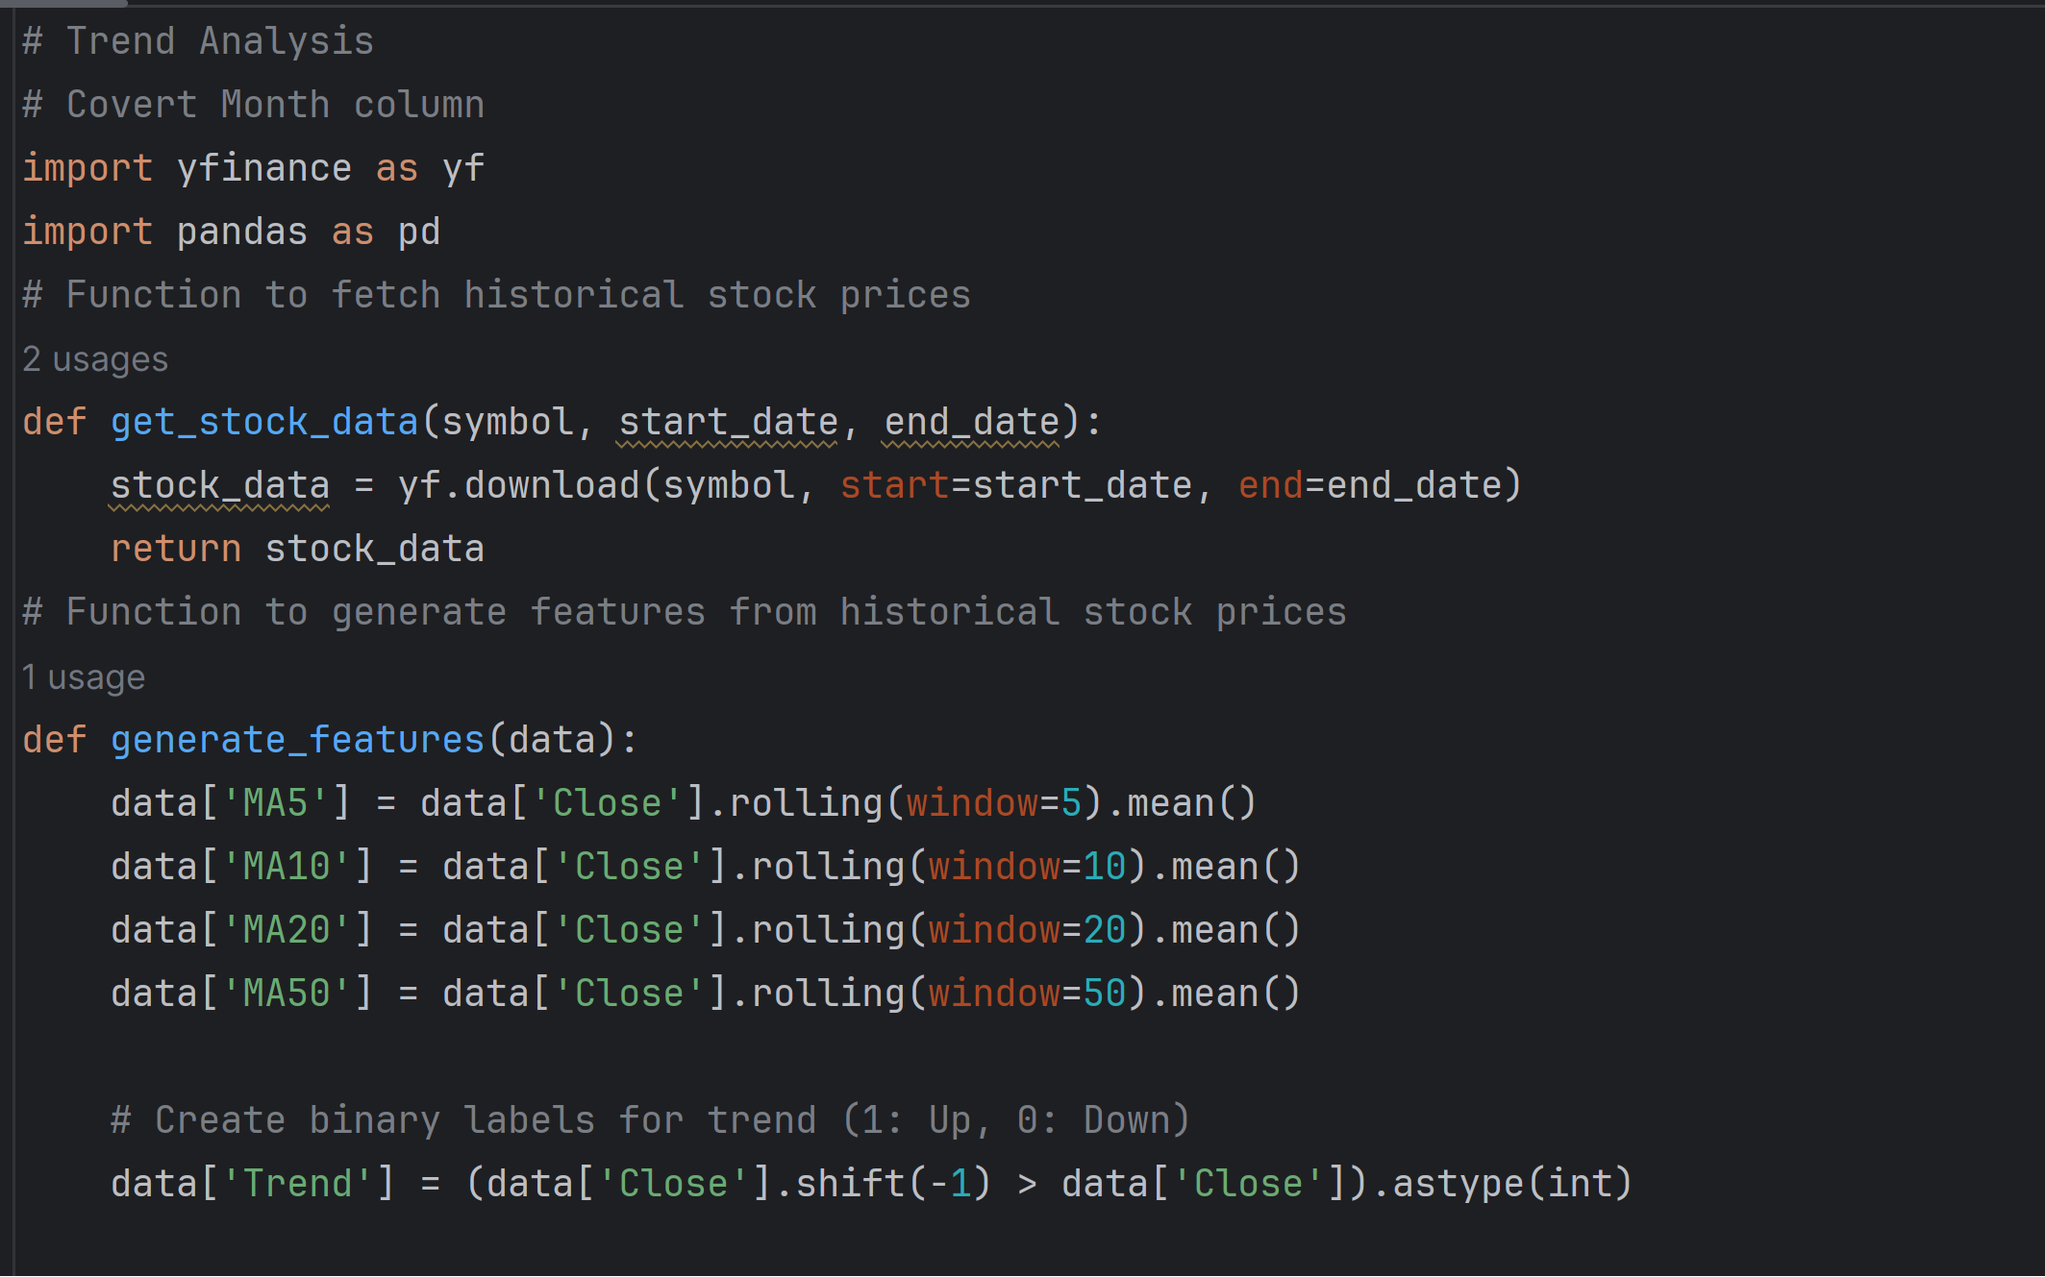
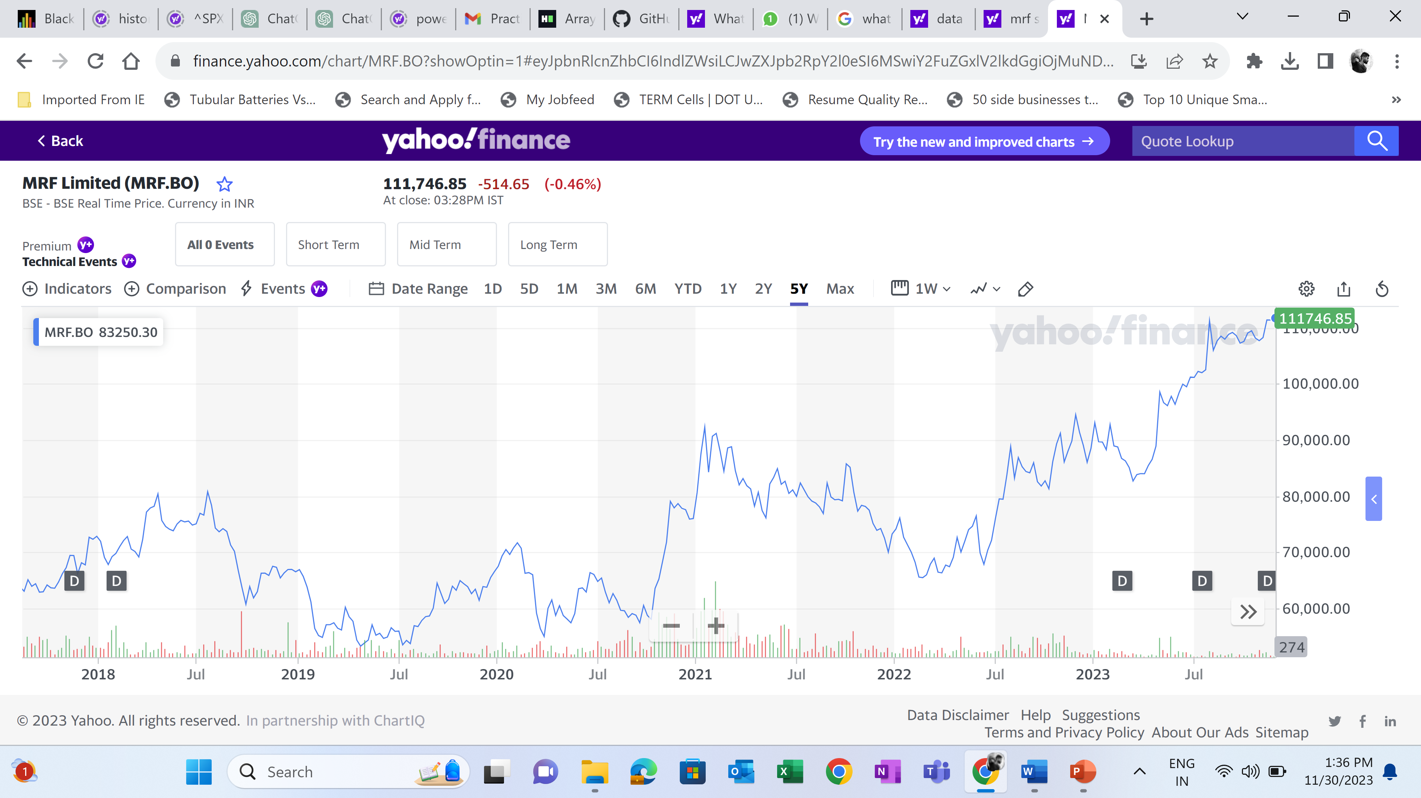
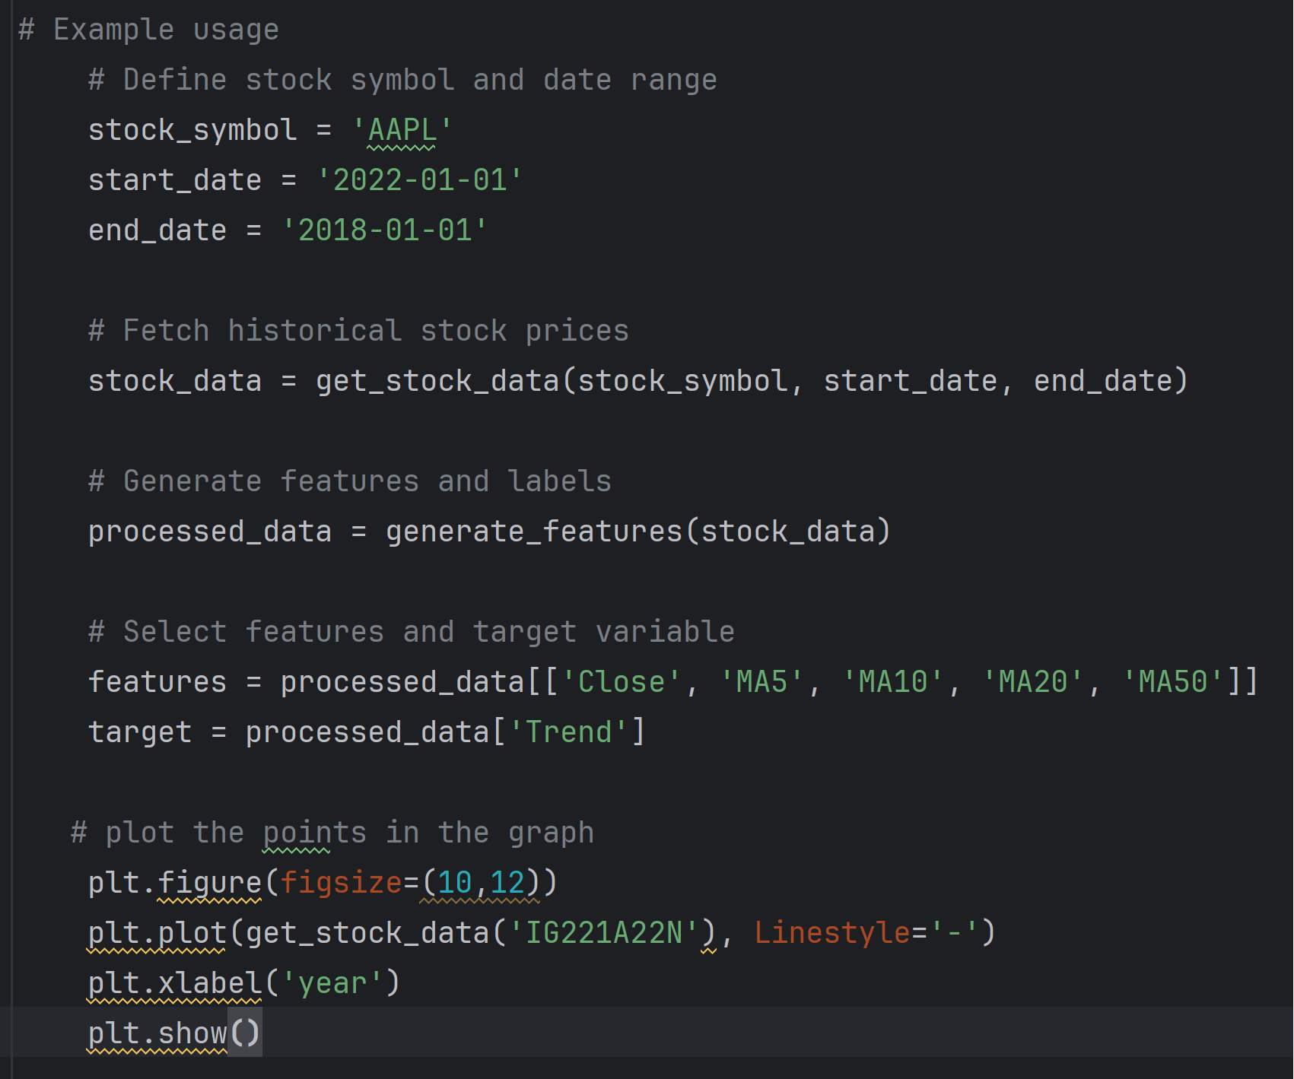
Trend Analysis

Slide 5
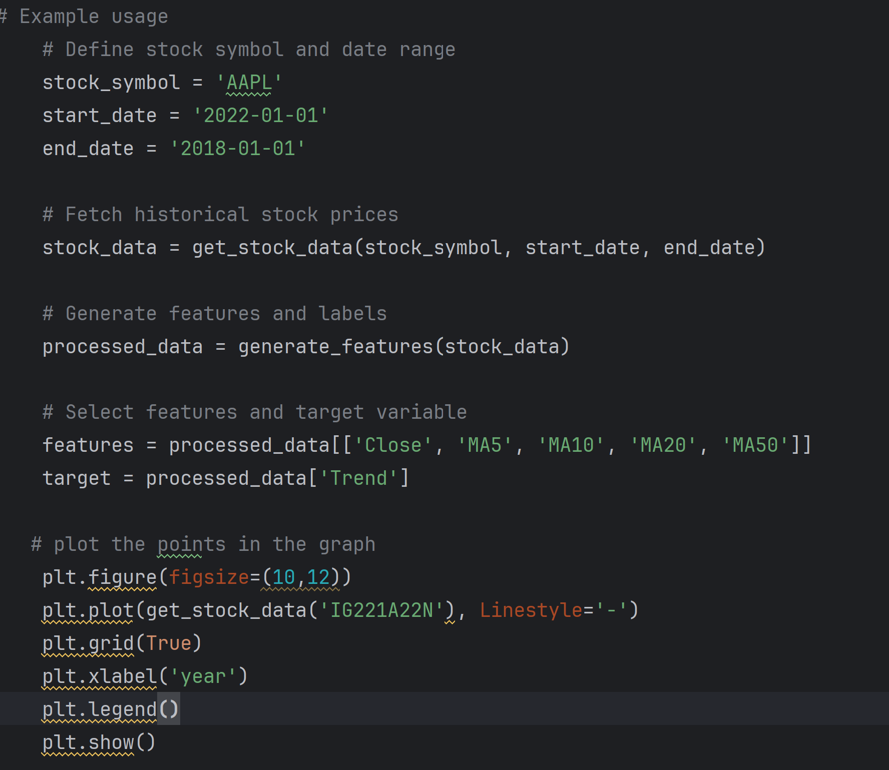
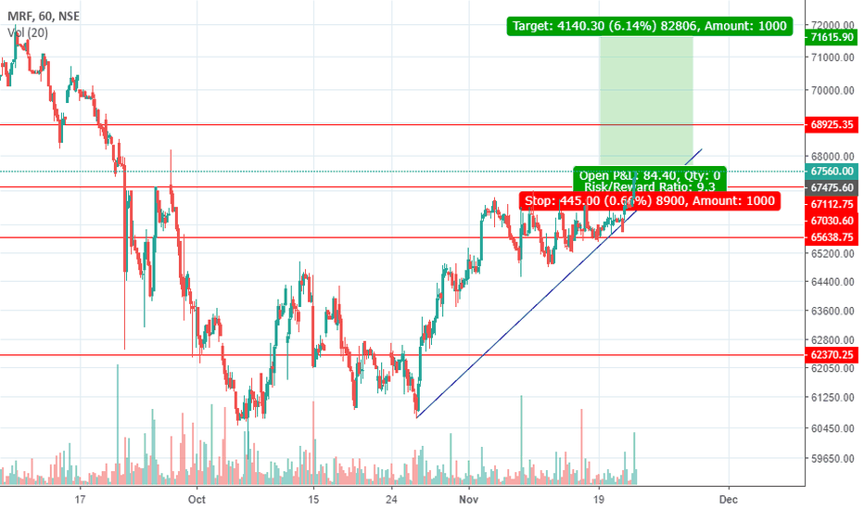
Trend identification

Slide 6
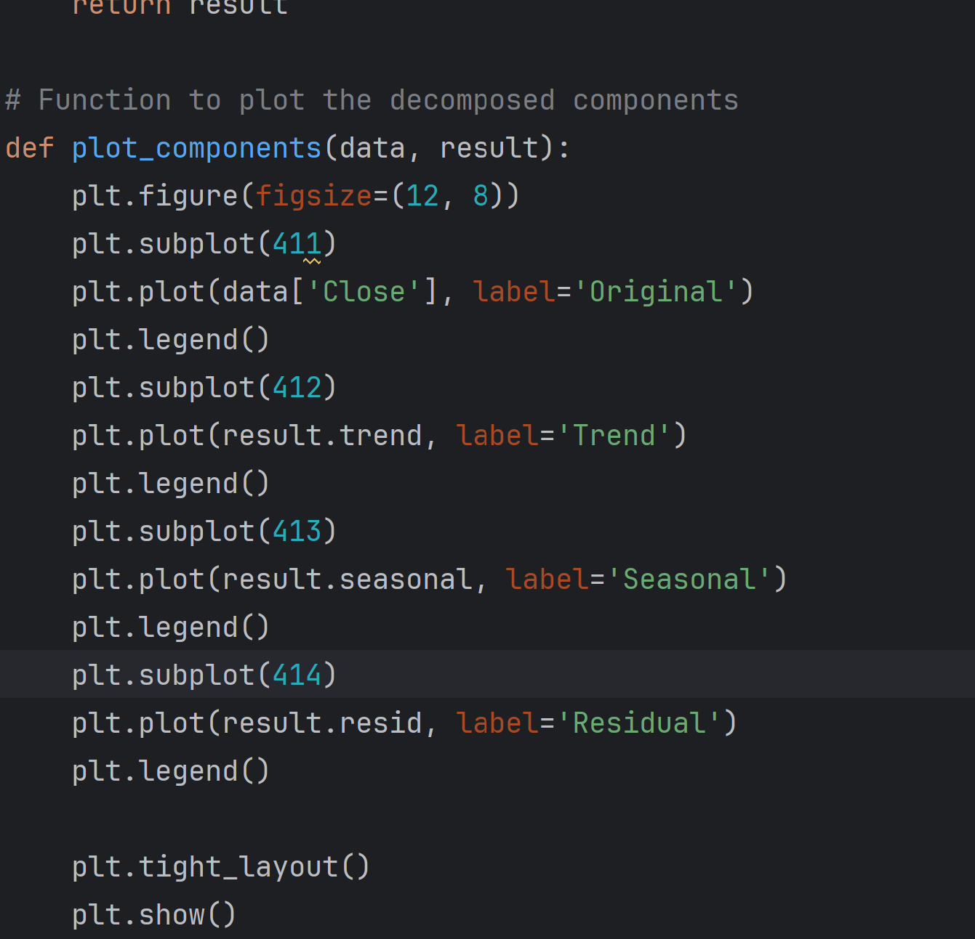
Seasonal trends

Slide 7
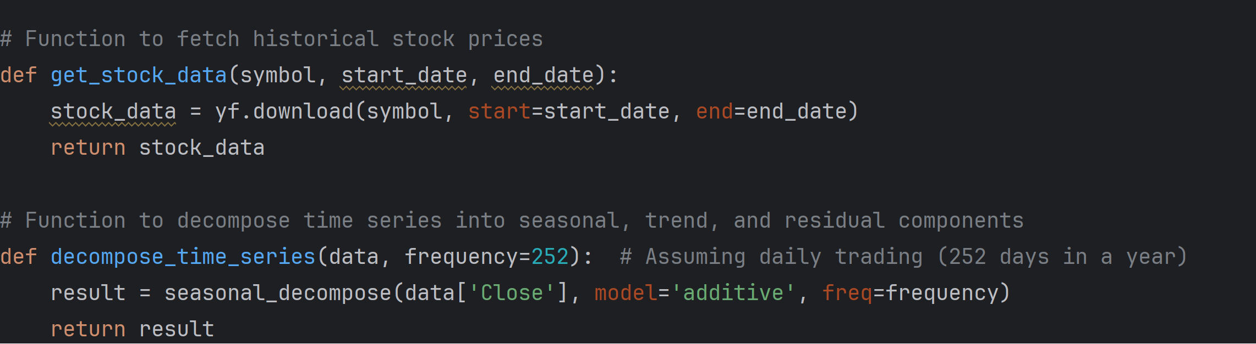
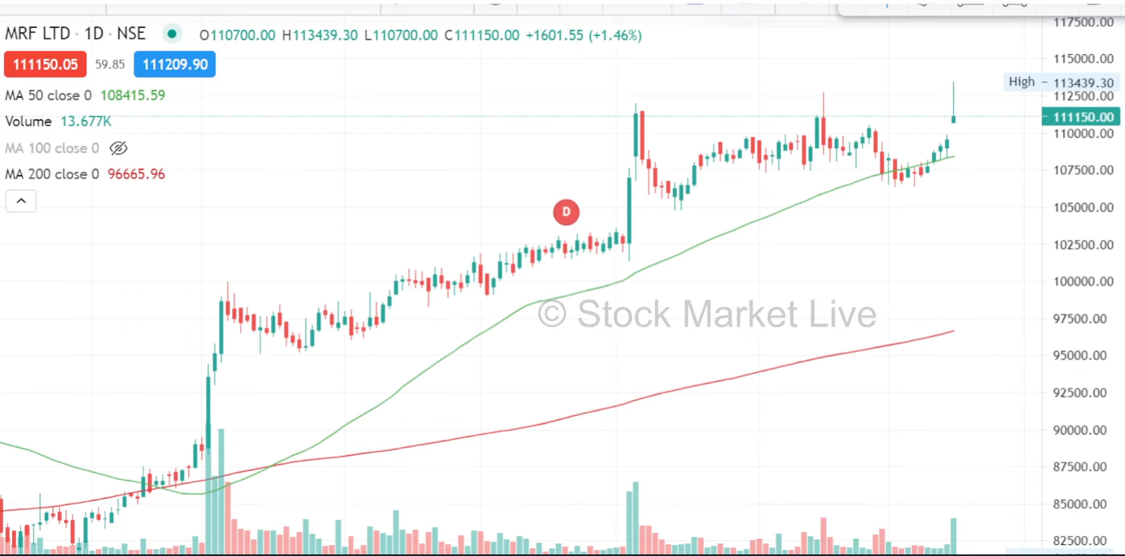
Trend Continuation

Slide 8
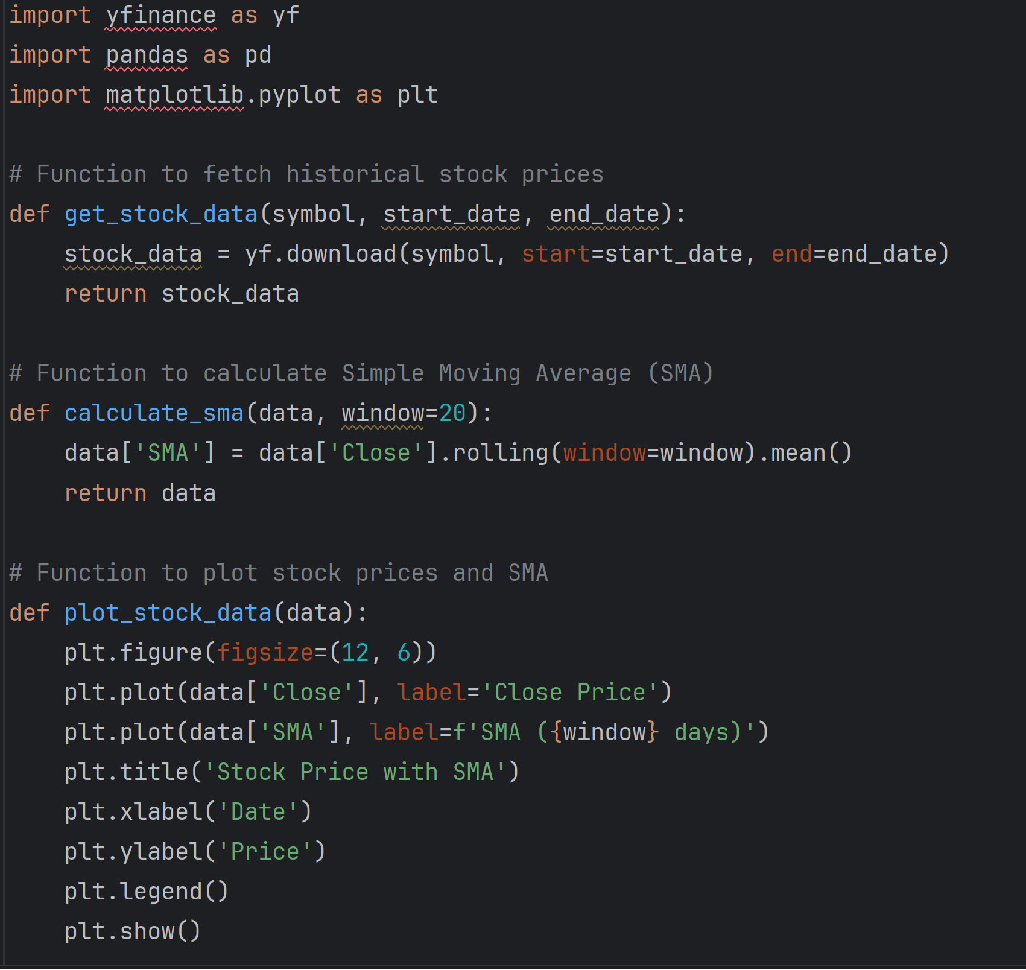
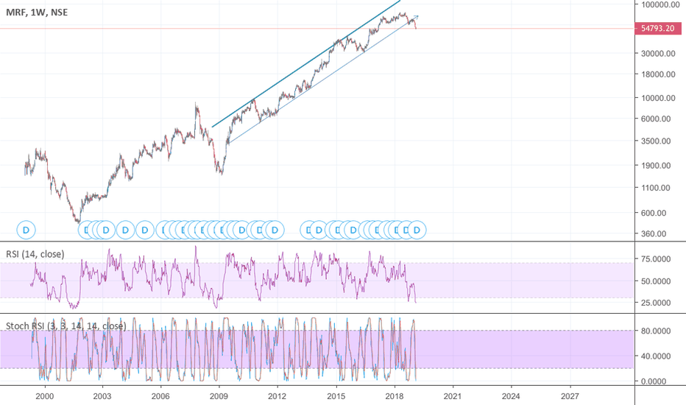
Forecasting

Slide 9
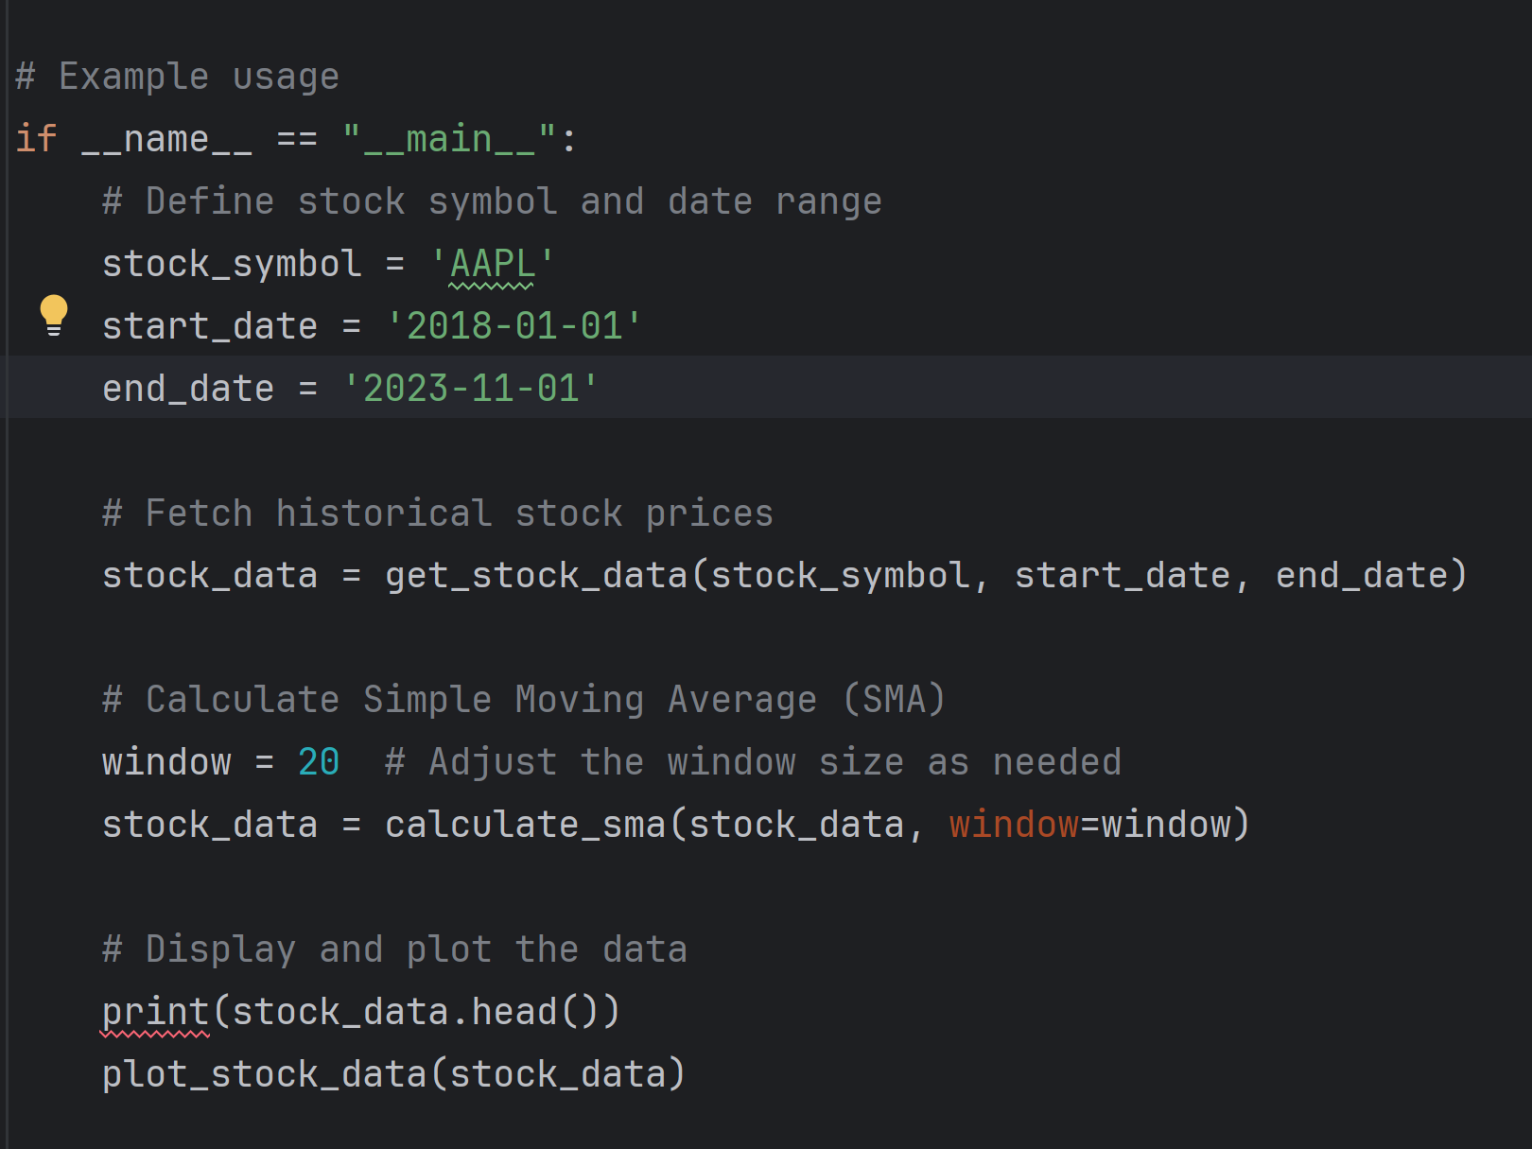
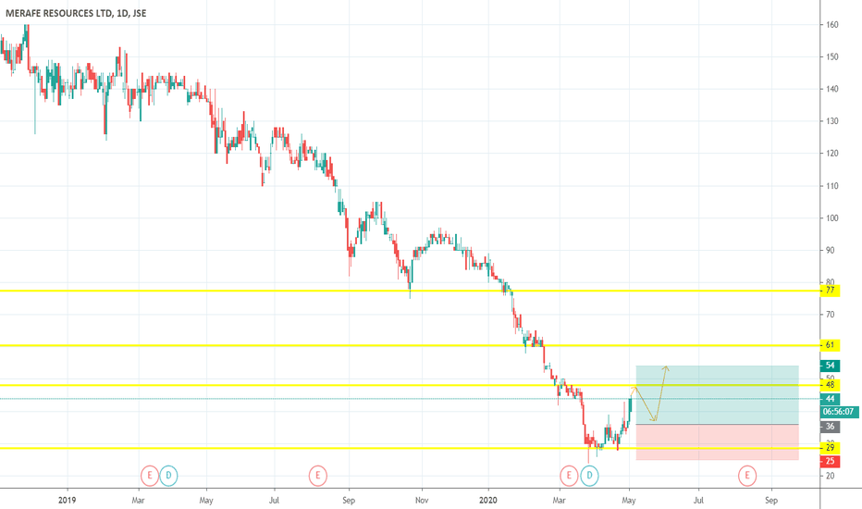
Forecasting Continues

Slide 10
THANK YOU!

